Slide 1
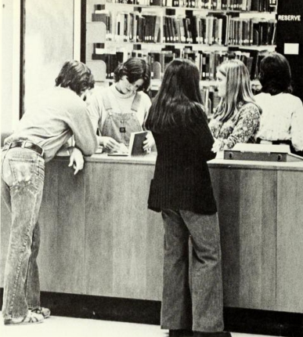
A-State Tutoring
Where Success is Learned
Notes:
In Fall 18 tutoring centers across campus came together in a concerted effort to collect and report on tutoring activity across campus.

Slide 2
COHORT
Notes:
There are nine centers that make up our tutoring cohort, and some of their data is represented here.

Slide 3
257%
F18-F19 Overall Increase in Reported Activity
Notes:
When we began this effort in Fall 2018, only five centers chose to participate in data collection through TARP, which ITS built specifically for us. Since then, we have added three more campus tutoring centers to the system, resulting in a 257% increase in reported activity from Fa18 - Fa19.

Slide 4
117%
215%
Overall Center Efficiency
Fall 2019: 193%
Fall 2018: 76%
Change in Percentage
Tutor- 40% Efficiency
Learning Group Leader- 126% Efficiency
(exp. Jeremy DeLon)
Notes:
TARP has allowed us to measure our overall center efficiency. This 117% increase in efficiency reflects individual and group tutoring across all centers from Fa 2018 - Fa 2019. We’ve also been able to measure individual tutor efficiency, which has allowed us to weigh the usefulness of learning groups over one-to-one tutoring. This 215% increase is just one example of the impact that a learning group leader can have in the participation of students enrolled in a high challenge course.

Slide 5
Faculty
In AY 19/20
Learning Support Services and the Writing Center hosted;
101 Classroom Visits &
72 Workshops
Notes:
These numbers represent participation between faculty, Learning Support Services, and the Writing Center for the AY 19/20 so far. Workshops include skills workshops, and Don’t Cancel Class sessions led by center tutors.

Slide 6
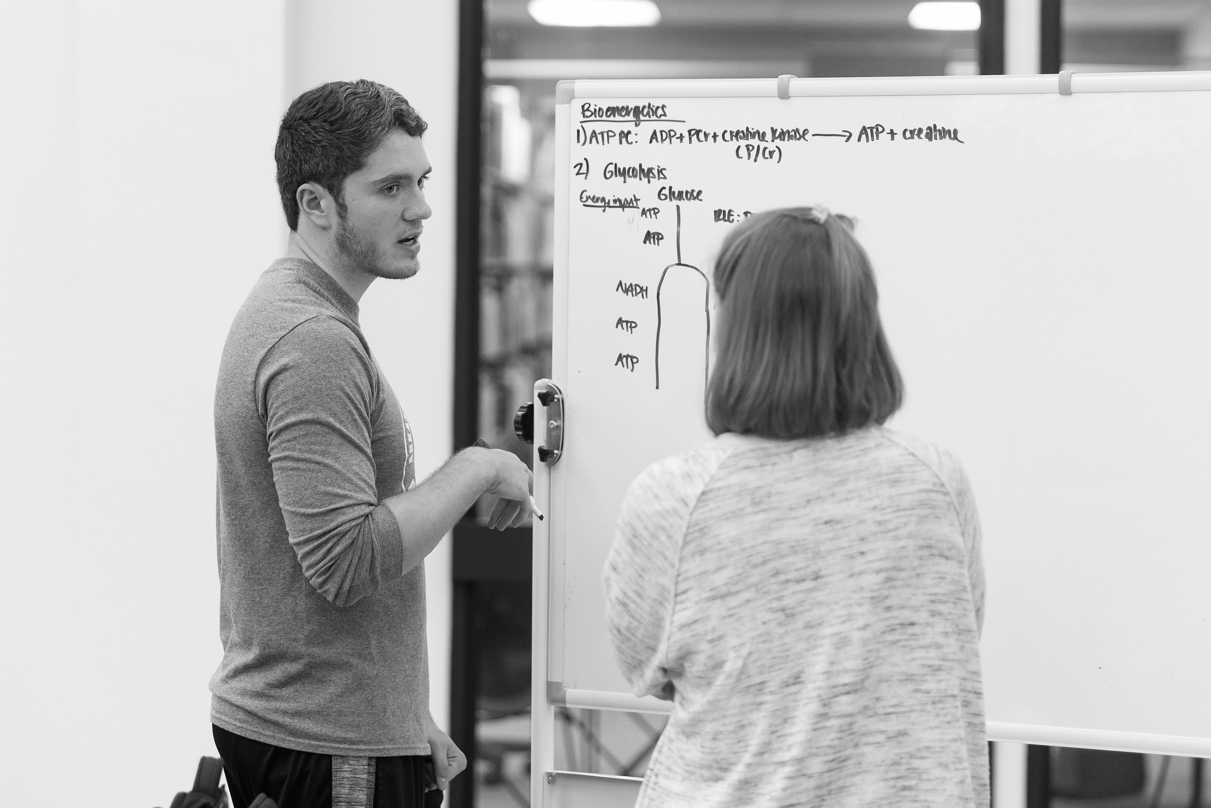
Increased Administrator Support
Comm Center
Notes:
Since tracking our data, our centers have been able to request additional resources, including space which has already resulted in the move of Learning Support services from one classroom to the third floor of the Library.

Slide 7
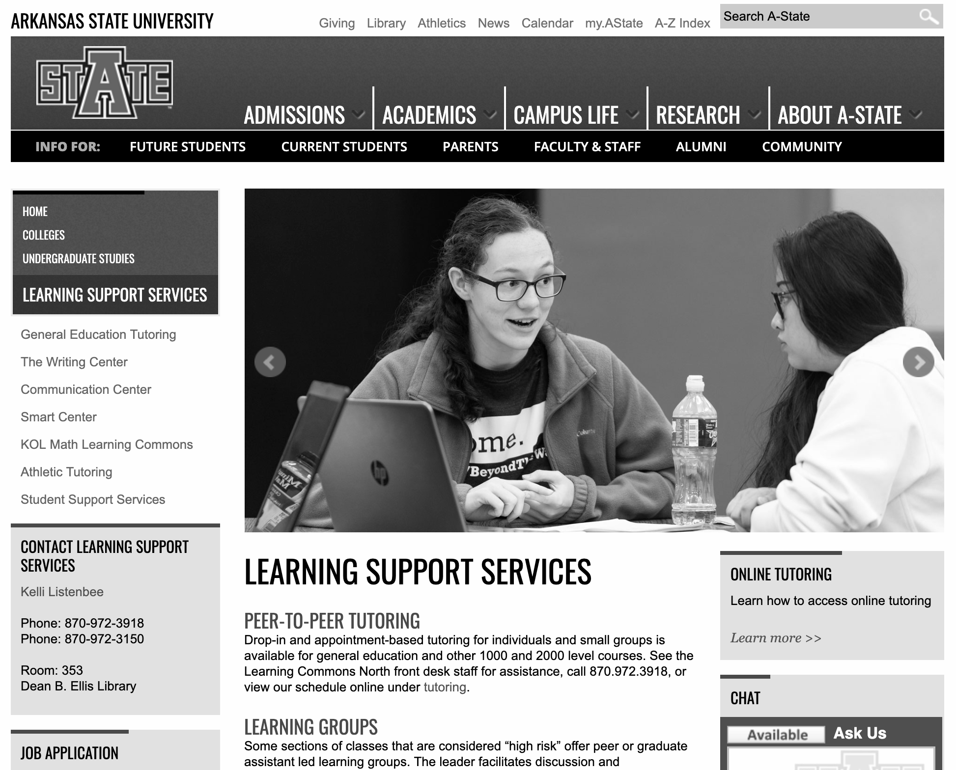
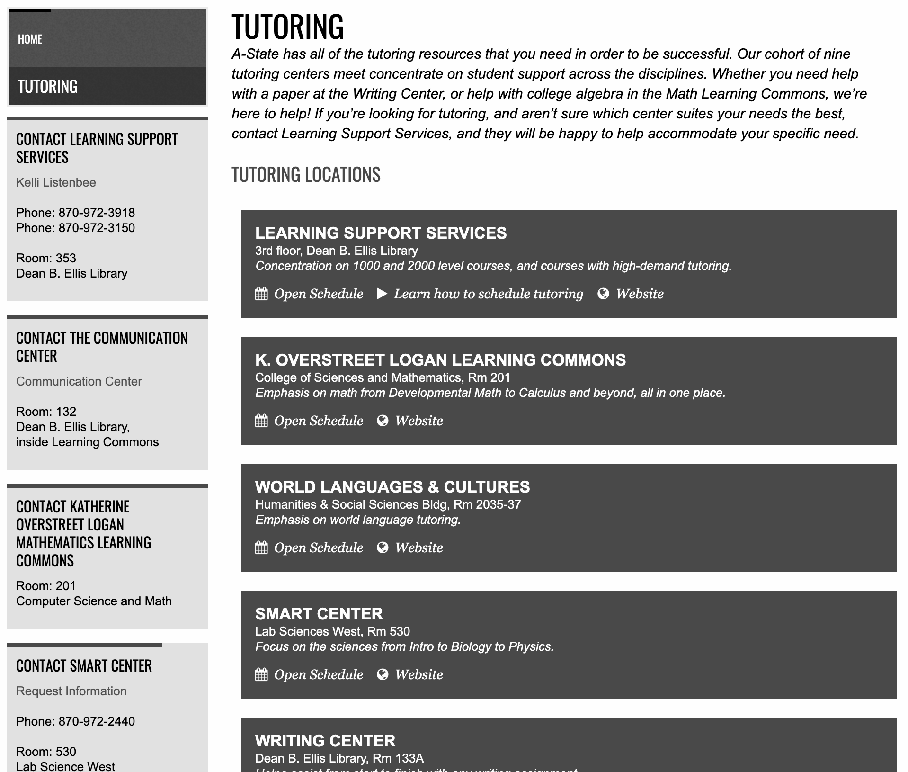
Creative Services
Notes:
A partnership with Creative Services allowed us to streamline the website, and create a cumulative tutoring page that allows students and advisors to more quickly find tutoring schedules for all of our learning centers.

Slide 8
4.27%
10%
Lift in persistence for students overall. Compared to 1.98% lift for freshmen nationally.
Lift in persistence for white males, readmit students, and students in the bottom quartile.
Notes:
After running a report in Illume Impact, we found that students who participate in tutoring receive a 4.27% lift in persistence as compared to students who don’t participate in tutoring. This is compared to a national average of 1.98% lift in persistence for first-year students. This number jumps to over 10% for white males, readmit students, and students in the bottom quartile.

Slide 9
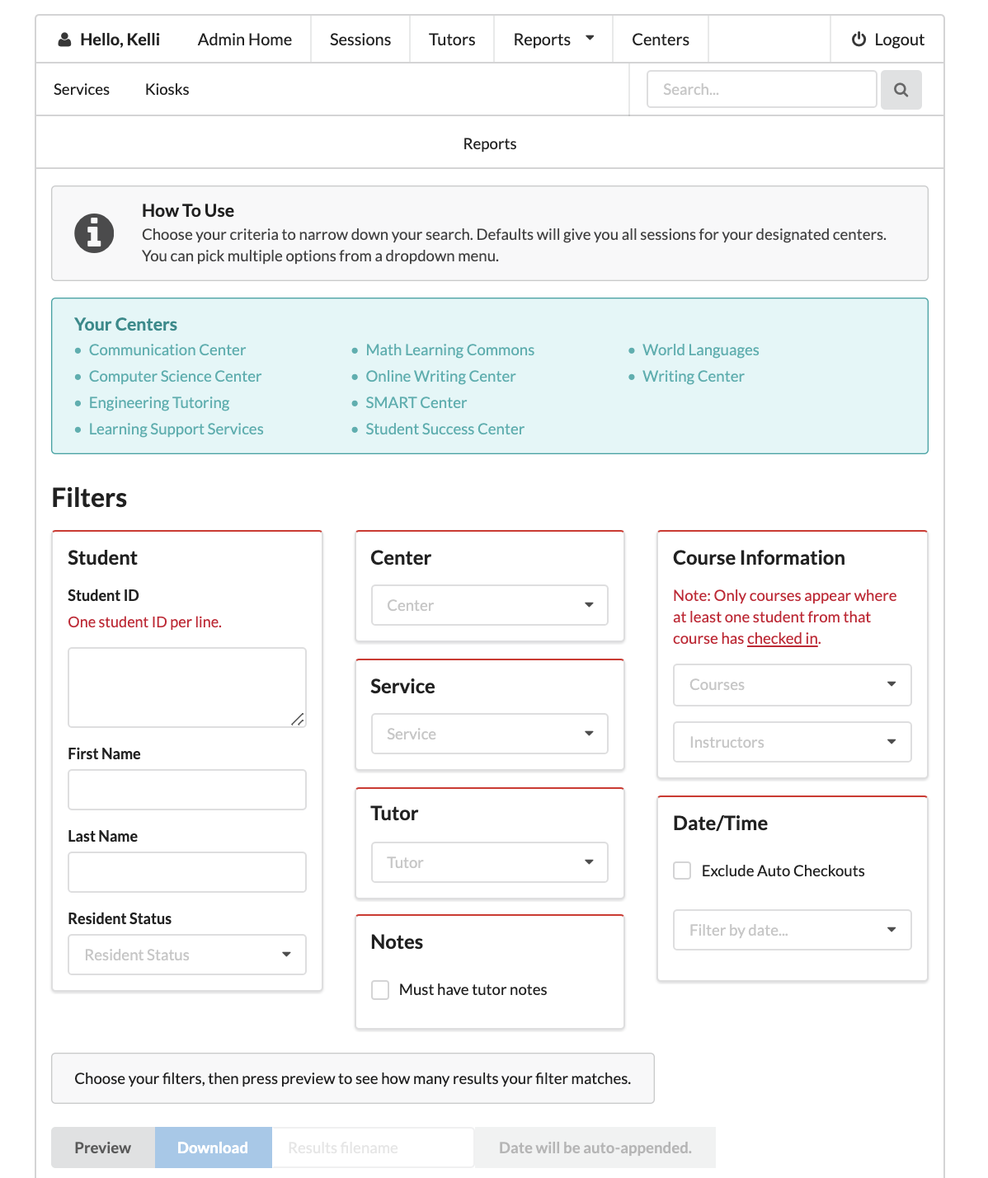
TARP
Notes:
TARP, the Tutoring and Assessment Reporting Program has continued to grow with us. We wouldn’t have been able to collect or report on any of the data mentioned here without our working relationship with IT.

